Slide 1

Department of Computer Science and Engineering VIGNAN’S LARA INSTITUTE OF TECHNOLOGY AND SCIENCE Project Review on
Question Answering System Based on BERT for Cancer Data
Under The Esteemed Guidance of
Mr. S. Deva Kumar, M.Tech, (Ph.D)
Assistant Professor
CSE Department
Presented By
Batch No: A5
B. Jyothi Swaroop(17FE1A0511)
A. Veena (17FE1A0507)
B. Veerendra (17FE1A0515)
B. Krishna Praneeth (17FE1A0513)
22-05-2021

Slide 2

Contents
Title
Abstract
Introduction
Literature Survey
Cancer Data
BERT
Architecture
Methodology
Sample Input & Output
References

Slide 3
Title
Question Answering System Based on BERT for Cancer Data

Slide 4
Abstract
Question Answering (QA) system is an information retrieval system during which an on-the-spot answer is predicted in response to a submitted query, instead of a collection of references which will contain the answers. The idea of QA system is to supply accurate straight forward answers to the questions for general public or medical practitioners. Fine-tuned / pre-trained BERT (Bidirectional Encoder Representation from Transformers) Model make this possible. This technique could help patients identify the type of Cancer in preliminary stages which could help save lives of individuals.

Slide 5
Introduction
With Advancements in the medical industry, most of the life cautionary diseases like cancer are treatable if diagnosed in early phases. But it is not common for general people to have proper understanding of possible symptoms, prevention measures of those diseases due to knowledge gap.
To solve this knowledge gap of life threatening diseases to general people using advanced Artificial Intelligence.

Slide 6
Literature Survey
Ref No | Title | Description | Methodology/Algorithms | Datasets Used | Performance Metrics | Results
1 | Infusing Disease Knowledge into BERT for Health Question Answering, Medical Inference and Disease Name Recognition | Knowledge of a disease includes information of various aspects of the disease, such as signs and symptoms, diagnosis and treatment can be fetch using pre-trained language models like BERT have shown success in capturing syntactic, semantic, and world knowledge from text, they can be further complemented by specific information like knowledge of symptoms, diagnoses, treatments, and other disease aspects by Question Answering. | BERT (Bidirectional Encoder Representation from Transformers) | 1.BioBERT 2.SciBERT 3.MEDIQA-2019 4.TRECQA-2017 | SOTA(state-of-the-art) values of Accuracy MRR(Mean Reciprocal Rank) Precision | Accuracy: 78.00 MRR: 93.67 Precision: 81.91

Slide 7
Literature Survey
Ref No | Title | Description | Methodology/Algorithms | Datasets Used | Performance Metrics | Results
2 | How Does BERT Answer Questions? A Layer-Wise Analysis of Transformer Representations | BERT reach state-of-the-art results in a variety of Natural Language Processing tasks. However, understanding of their internal functioning is still insufficient and unsatisfactory. In order to better understand BERT and other Transformer-based models, we present a layer-wise analysis of BERT’s hidden states. Specifically, our analysis focuses on models fine-tuned on the task of Question Answering (QA) as an example of a complex downstream task. | BERT (Bidirectional Encoder Representation from Transformers) GPT-2 (Generative Pre-trained Transformer-2) | 1.SQuAD (Stanford Question Answering Dataset), 2.bAbI QA Dataset | ----- | ----

Slide 8
Literature Survey
Ref No | Title | Description | Methodology/Algorithms | Datasets Used | Performance Metrics | Results
3 | Information Retrieval and Extraction on COVID-19 Clinical Articles Using Graph Community Detection and Bio-BERT Embeddings | Information retrieval system on a corpus of scientific articles related to COVID-19. shared citations and bio-logical domain-specific sentence embeddings. Ego-splitting community detection on the article network is employed to cluster the articles and then the queries are matched with the clusters. Extractive summarization using BERT and PageRank methods is used to provide responses to the query. | BERT(Bidirectional Encoder Representation from Transformers), ego-splitting community detection algorithm for clustering | COVID-19 Open Research Dataset (CORD-19) | Questions and Answers with Confidence Score | Q)What are extra pulmonary manifestations of COVID-19? Ans. 1.Orbital sinus bleeding : 92.95(Confidence Score) 2. Invasive Devices : 90.21(Confidence Score)

Slide 9
Literature Survey
Ref No | Title | Description | Methodology/Algorithms | Datasets Used | Performance Metrics | Results
4 | BioBERT: a pre-trained biomedical language representation model for biomedical text mining | The progress in natural language processing (NLP), extracting valuable information from biomedical literature has gained popularity among researchers. However, directly applying the advancements in NLP to biomedical text mining often yields unsatisfactory results due to a word distribution shift from general domain corpora to biomedical corpora. In this article, they investigate how the recently introduced pre-trained language model BERT can be adapted for biomedical corpora | Named Entity Recognition (NER) BERT (Bidirectional Encoder Representation from Transformers) | BioBERT (+PubMed) Wiki + Books + PubMed BioBERT (+PMC) Wiki + Books + PMC BioBERT (+PubMed + PMC) Wiki + Books + PubMed + PMC | SOTA(state-of-the-art) values of Precision (P), Recall (R) ,and F1 (F) scores F1 score =2*(precision*recall)/(precision + recall) | Precision score: 79.21 Recall score: 89.25 F1 score: 83.93

Slide 10
Cancer Data
In this work, we are implementing the Question Answering System based on Bert on the Cancer Data.
For that we are taking 5 different types of cancers which are most infusing cancers among the all the types. Which was stated by a Nonprofitable American academic medical center of integrated health care, education, and research named Mayo Clinic.
The Cancer Types are :
Breast Cancer
Prostate Cancer
Lung Cancer
Colorectal Cancer
Skin Cancer

Slide 11
Cancer Data
Breast cancer is cancer that forms in the cells of the breasts.
Prostate cancer is cancer that occurs in the prostate. The prostate is a small walnut-shaped gland in males that produces the seminal fluid that nourishes and transports sperm
Lung cancer is a type of cancer that begins in the lungs. lungs are two spongy organs in your chest that take in oxygen when you inhale and release carbon dioxide when you exhale
Colorectal cancer is a type of cancer that begins in the large intestine (colon). The colon is the final part of the digestive tract.
Skin cancer is the abnormal growth of skin cells. it is most often develops on skin exposed to the sun.

Slide 12
BERT – Bidirectional Encoder Representation from Transformers
BERT (Bidirectional Encoder Representation from Transformers) is a recent paper published by researchers at Google AI Language in 2018.
BERT is a Transformer-based machine learning technique for natural language processing (NLP) pre-training developed by Google.
BERT is a deeply bidirectional, unsupervised language representation.
BERT uses two training strategies:
1. MLM (Masked Language Model)
2. NSP (Next Sentence Prediction)

Slide 13
BERT Architecture
Figure: Architecture of BERT

Slide 14
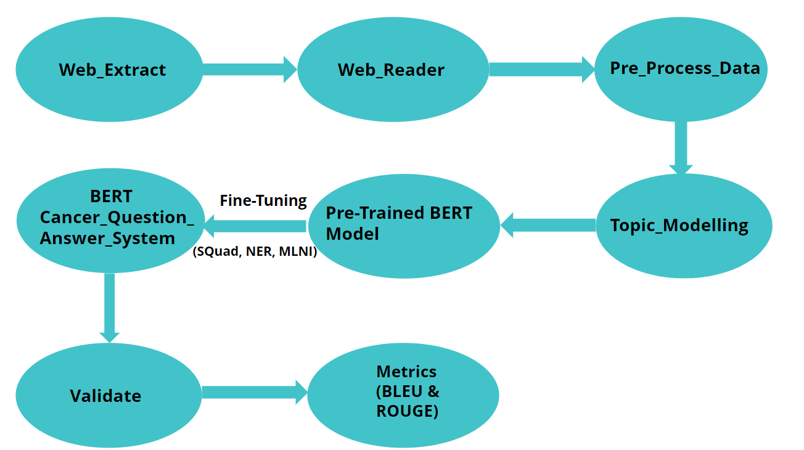
Methodology
Figure : Block Diagram Representation of BERT Cancer Question Answering System

Slide 15
Methodology
Step 1: Information Extraction
Step 2: Topic Modelling
Step 3: Questions Preparation
Step 4: Implementing BERT Question-Answering System
Step 5: Metrics & Evaluation

Slide 16
1. Information Extraction
Web scraping was used to extract the data from the trusted public domain web resources about different cancer data.
Extracted data was stored in a text format in the Text files.
Those data was intent to pre-process without removing stop words where BERT system identify the context from L-R and R-L.

Slide 17
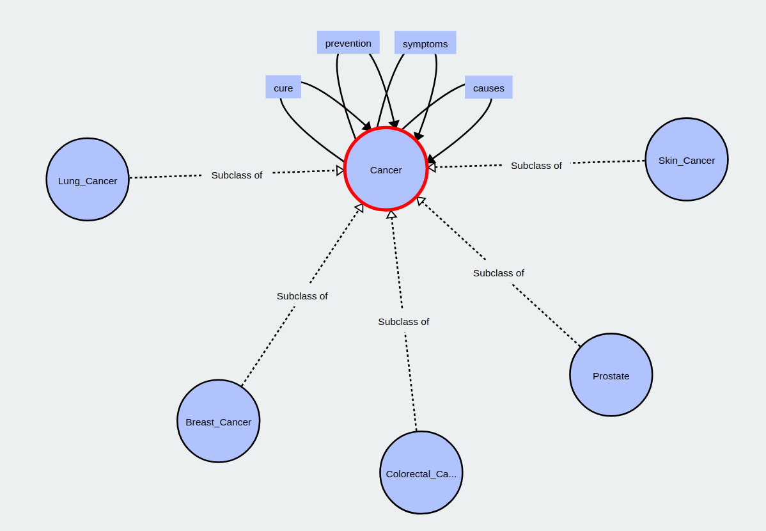
1. Information Extraction
Figure: Properties and Types of Cancer Data using OWL (Web Ontology Language) Diagram

Slide 18
2. Topic Modelling
Data we collected from different web sources using web scraping and the data is categorized different types of cancers using topic modelling.
Topic modeling is a type of statistical modeling for discovering the abstract topics that occur in a collection of documents. Latent Dirichlet Allocation (LDA) is an example of topic model and is used to classify text in a document to a particular topic.
LDA assumes documents are produced from a mixture of topics. Those topics then generate words based on their probability distribution. Given a dataset of documents, LDA backtracks and tries to figure out what topics would create those documents in the first place.

Slide 19
3. Questions Preparation
Different questions need to be prepared manually for the testing of the Question Answering system.
Questions varies for each cancer type such as Breast Cancer, Prostate Cancer, Lung Cancer, Colorectal Cancer and Skin Cancer.
For each Cancer type, the questions prepared for each property such as Causes, Prevention, Symptoms and Cure.
Finally prepared questions are stored in a JSON (JavaScript Object Notation) Format File Specified with which type of Cancer and on which property the query is to be related.

Slide 20
4. Implementing BERT Question Answering System
Installed hugging face transformers library and from that transformers loaded pre-trained BERT-large model.
BERT-large is big. it has 24 hidden layers and an embedding size of 1,024 MB, for a total of 340M parameters. Altogether it having 1.34GB of size.
Fine-Tuned the BERT model with SQUAD (Stanford Question Answering Dataset), NER (Named Entity Recognition), MLNI (Multi Natural Language Inference) to transform into BERT Question Answering System.
Model and Tokenizer Initialization, Query/Question and Paragraph tokenization, Answer Prediction are the main activities need to be performed in this BERT Question Answering System.

Slide 21
5. Metrics & Evaluation
To evaluate the performance of QA System implemented by BERT Model with our custom data, Bilingual Evaluation Understudy (BLEU) and Recall-Oriented Understudy for Gisting Evaluation (ROUGE) which helpful to evaluate the score for comparing a candidate translation of text to one or more reference translations and evaluating automatic summarizing of texts as well as machine translation, respectively.
The precision and recall scores of BLEU() and ROUGE() models on cancer data.

Slide 22
Sample Input & Output
Sample Input :
Question:
What are Less common symptoms of lung cancer?
Paragraph:
Most lung cancers don't cause symptoms until the disease has advanced, in part because the lungs have few nerve endings. When lung cancer does cause signs in its early stages, they may vary from person to person but commonly include: A new cough that is persistent or worsens, or a change in an existing chronic cough. Cough that produces blood Pain in the chest, back or shoulders that worsens during coughing, laughing or deep breathing Shortness of breath that comes on suddenly and occurs during everyday activities Unexplained weight loss Feeling that you are tired or weak Loss of appetite Lung infections such as bronchitis or pneumonia that won't go away Hoarseness or wheezing Less common symptoms of lung cancer may include: Swelling in the face or neck Difficulty swallowing or pain while swallowing Changes in the appearance of fingers, called finger clubbing Although most of these symptoms are more likely to be caused by something other than lung cancer, it's important to see a doctor. Discovering lung cancer early may mean more treatment options are available.
Sample Output :
BERT_QA_System(Question, Paragraph)
Swelling in the face or neck Difficulty swallowing or pain while swallowing Changes in the appearance of fingers, called finger clubbing

Slide 23
References
“Infusing Disease Knowledge into BERT for Health Question Answering, Medical Inference and Disease Name Recognition” by Yun He, Ziwei Zhu, Yin Zhang, Qin Chen, James Caverlee, arXiv:2010.03746v1, 8 Oct 2020.
“How Does BERT Answer Questions? A Layer-Wise Analysis of Transformer Representations” by Betty van Aken, Benjamin Winter, Alexander Löser, Felix A. Gers, arXiv:1909.04925v1, 11 Sep 2019.
“Information Retrieval and Extraction on COVID-19 Clinical Articles Using Graph Community Detection and Bio-BERT Embeddings” by Debasmita Das, Yatin Katyal, Janu Verma Shashank Dubey, Aakash Deep Singh, Kushagra Agarwal, Sourojit Bhaduri, Rajesh Kumar Ranjan, In Conference Proceedings of the 1st Workshop on NLP for COVID-19 at ACL 2020.

Slide 24
References
“BioBERT: a pre-trained biomedical language representation model for biomedical text mining” by Jinhyuk Lee ,Wonjin Yoon , Sungdong Kim, Donghyeon Kim ,Sunkyu Kim , Chan Ho So and Jaewoo Kang, at Oxford academic journals Bioinformatics, Volume 36, Issue 4, 15 February 2020, Pages 1234–1240.
“BERT: Pre-training of Deep Bidirectional Transformers for Language Understanding” by Jacob Devlin, Ming-Wei Chang, Kenton Lee and Kristina Toutanova, Google AI Language, arXiv:1810.04805v2 [cs.CL], 24 May 2019.

Slide 25
Any Queries?

Slide 26
Thank You

